Slide 1
Revisits & Onboarding
Exploring balance
July 2022

Slide 2
Tl;dr Onboardings lead to higher long-term MTMs vs. Revisits
3.7x
Uplift in #MTMs by onboardings vs, revisits
1.2x
Cost/MTM for revisits vs. onboardings
59pp
HighInt merchants activated via Onboardings
Tl:Dr;
Onboarding leads to 3.7x MTMs vs. Revisits after three months
Quality (Txn Intensity) of MTMs generated via onboardings is better vs. Revisits; Health of 10M - Phase 2
Cost/MTM is 1.2x higher for revisits vs. onboardings;
Cost/MTM for active_revisits > onboardings > resurrections
 | Total Ob | Total Revisits | Inactive @ Revisit | Active @ Revisit
FOS Agents | 2500 | 2500
FOS Productivity | 4 |  | 2 | 4
FOS Lift | 82% |  | 50% | 92%
Organic | 15% |  | 6% | 79%
Immediate | 6,690 | 1,660 | 880 | 780
M1 | 6,143 | 1,540 | 760 | 780
M2 | 5,236 | 1,379 | 599 | 780
M3 | 4,844 | 1,300 | 520 | 780
Cost/MTM | 727 | 962 | 673 | 1,154
So What:
Increase onboardings by repurposing 20-50% of revisits to gain 200-500k incremental MTMs in 2x total cost, assuming cost isn’t a constraint
If cost is a constraint, Re-allocate budgets for 75% of active revisits to onboardings to gain ~100k incremental MTMs;
Note:
M1, M2 and M3 MTMs calculated based on calculated retention decay across all three FOS actions
Netted by Organic Onboardings (Self-signups), FOS Revisits , org, resurrection & retention to get to Incremental gain
Assuming total FOS agents as 5k are equally distributed b/w onboardings and revisited, and further 60%, 40% between active versus inactive revisits
FOS operational challenges could not be considered while calculating approx. incremental MTMs

Slide 3
Contents
Tl;dr
Scope of Analysis
Top Line Impact & Post-period decay
Long-term MTMs via onboardings and revisits (Split by resurrection & retention)
Quality of MTMs i.e. %HighInt merchants
Cost/MTM via onboardings and revisits
Summary of Recommendations

Slide 4
Scope of the analysis
Total MTMs = Retained + Resurrected + New Onboarding
Organic and Product Led
Experience
Product Features
Reliability
Offers/Rewards
Brand Preference
Organic
Outbound Calls
Self-onboards
Objective: Maximize
FOS Led
Scope of the analysis
Revisits - Relationship Management/TOM recall
Onboardings
Timeframe
Dec’21 - June’22 data
Analysed over 3 months for long-term metrics
FOS Constraints (TBD)
Agents productivity
#FOS Agents
Data Constraints
In this analysis we could not explore
impact of revisits to solve for stuck settlements / introduce VAS features to merchants etc. due to lack of data on the same
Multiple revisits

Slide 5
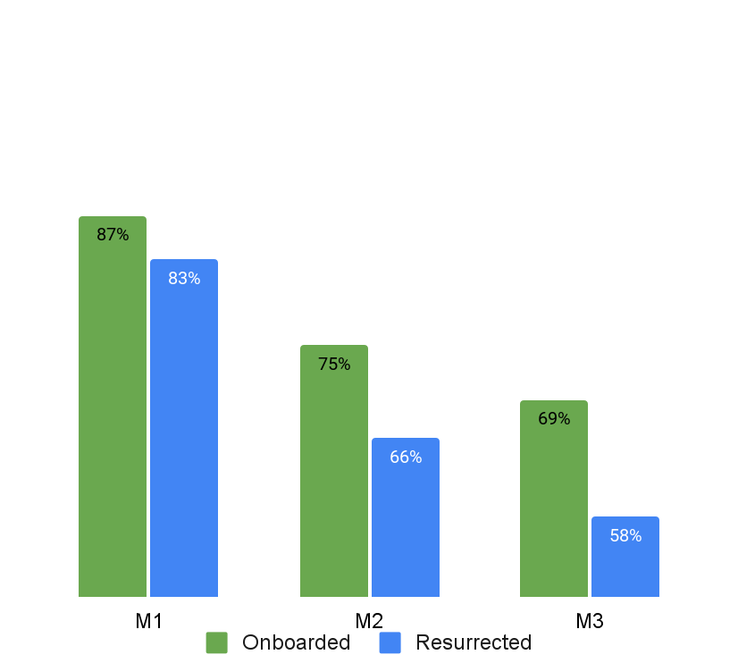
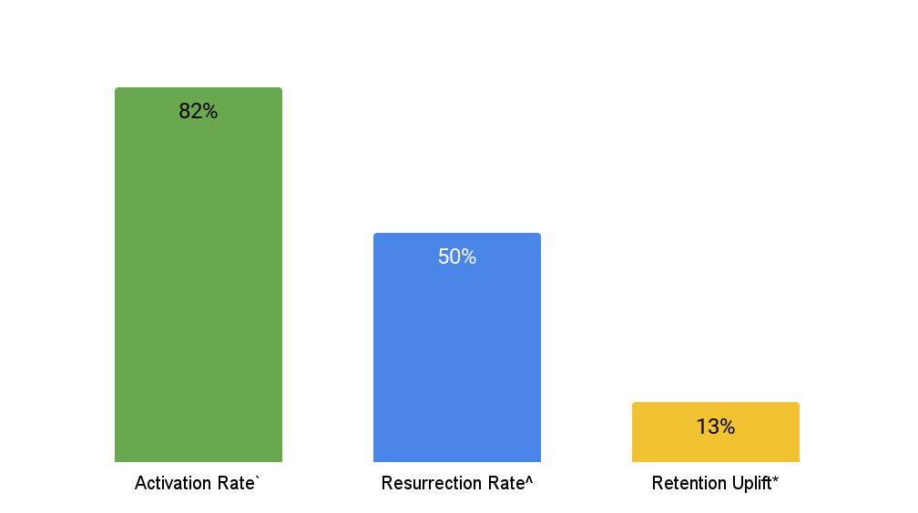
Activation rate @82% is 1.5x resurrection rate & 6.3x retention uplift
Retention decays MoM; Decay in onboardings is 11pp lower vs. resurrection. Retention uplift flat @13%
Net activation for onboardings (FOS activations - selfonboards) is 23pp higher vs. net resurrection
Onboarded merchants retain 11pp better vs. Resurrected after three months
FOS Onboarding
FOS Revisits
Note:
` Onboarding activation rate is calculated on 2 weeks window after onboarding date
^ Resurrection rate is calculated on 2 weeks window after revisiting date
* Retention uplift is difference b/w 28D retention for revisited and organic retention
Impact for onboardings and resurrection is calculated after netting of the organic onboards and resurrections

Slide 6
Onboarding leads to 3.7x MTMs vs. Revisits after three months
Retention uplift between FOS and organically retained merchants remains constant @13% MoM
For each additional FOS agents deployed, onboardings lead to 3.7x MTMs vs. revisits
 | Total Ob | Total Revisits | Inactive @ Revisit | Active @ Revisit
FOS Agents | 2500 | 2500
FOS Productivity | 4 |  | 2 | 4
FOS Lift | 82% |  | 50% | 92%
Organic | 15% |  | 6% | 79%
Immediate | 6,690 | 1,660 | 880 | 780
M1 | 6,143 | 1,540 | 760 | 780
M2 | 5,236 | 1,379 | 599 | 780
M3 | 4,844 | 1,300 | 520 | 780
Cost/MTM | 727 | 962 | 673 | 1,154
Self-onboards retain at 68% at M1, while organic resurrected merchants retain at 60% at M1
Retention uplift is calculated on 28D time period while resurrection & activation is calculated on 15D
Prioritize onboardings over revisits to generate higher # long-term MTMs
Note:
M1, M2 and M3 MTMs are based on calculated retention decay across all three FOS actions
Netted by Organic Onboardings (Self-signups), FOS Revisits , org, resurrection & retention to get to Incremental gain
Assuming total FOS agents as 5k are equally distributed b/w onboardings and revisited, and further 60%, 40% between active versus inactive revisits

Slide 7
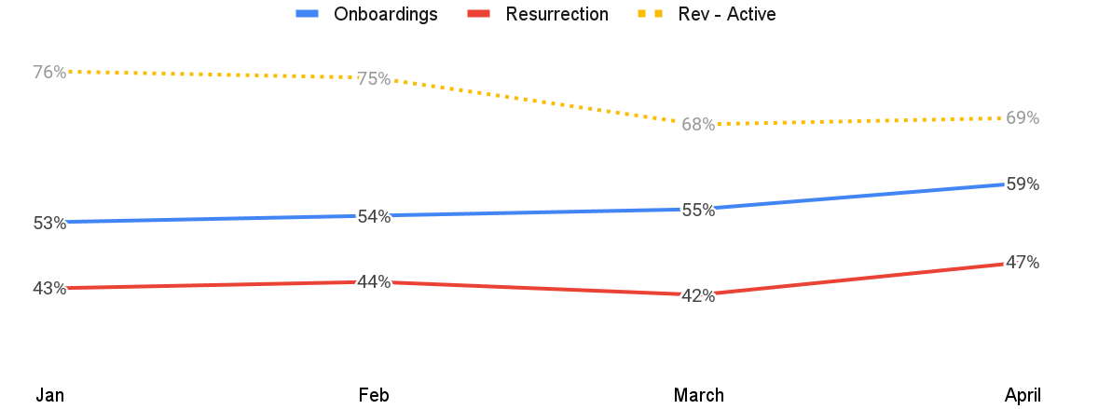
Onboardings generate more high quality merchants vs. revisits MoM
Avg. TI within health segment 5 of resurrected merchants is 46 txns, while for activated merch it’s 54 txns
High Intensity segment is indicator of good quality of merchants; High Intensity merchants retain longer
%merchants in HighInt segment after onboarding, resurrecting & active-revisits
3
4. LowInt
1
1.8M g
1-6 txn
61%
2
Improving quality
5. HighInt
2M g
>6 txn
96%
Quality of onboarded merchants continue be high MoM
Onboardings generate larger number of high quality merchants vs. revisits
%High Quality merchants in active revisits is function of merchant base revisits. April: %highInt merchants before revisit: 58%; Incremental 11% improved quality
1
2
3
Note:
%HighInt merchants in active revisits is function of active base visited
Onboarding cohort means activated merchants due to onboardings

Slide 8
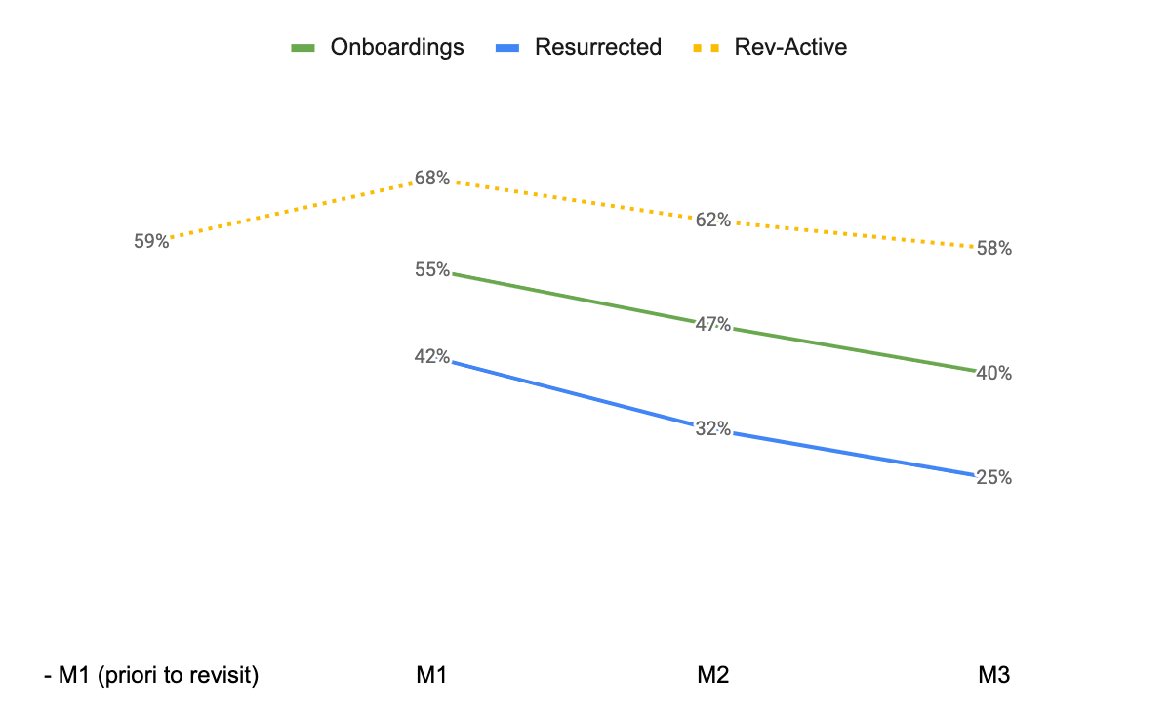
Quality improvement (Txn intensity) due active revisits lasts for 3 months
Onboardings continue to generate higher % of quality merchants vs. resurrections
Decay in High Quality segments across Onboardings, Resurrected and Active Revisits
1
1
%High Quality merchants for active revisits come down to pre-revisit level i.e. quality improvement is temporary and only lasts for three months
%High Quality merchants decay 2pp faster for resurrection vs. onboardings in 3 months
1
2
2
Optimize revisits to maximize incremental benefit
Note:
%HighInt merchants in active revisits is function of active base visited

Slide 9
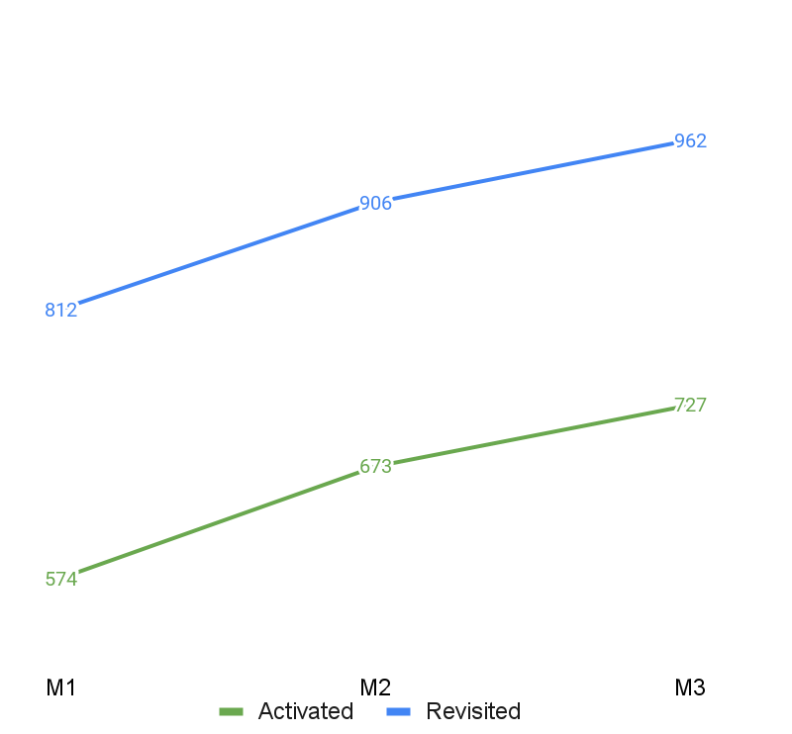
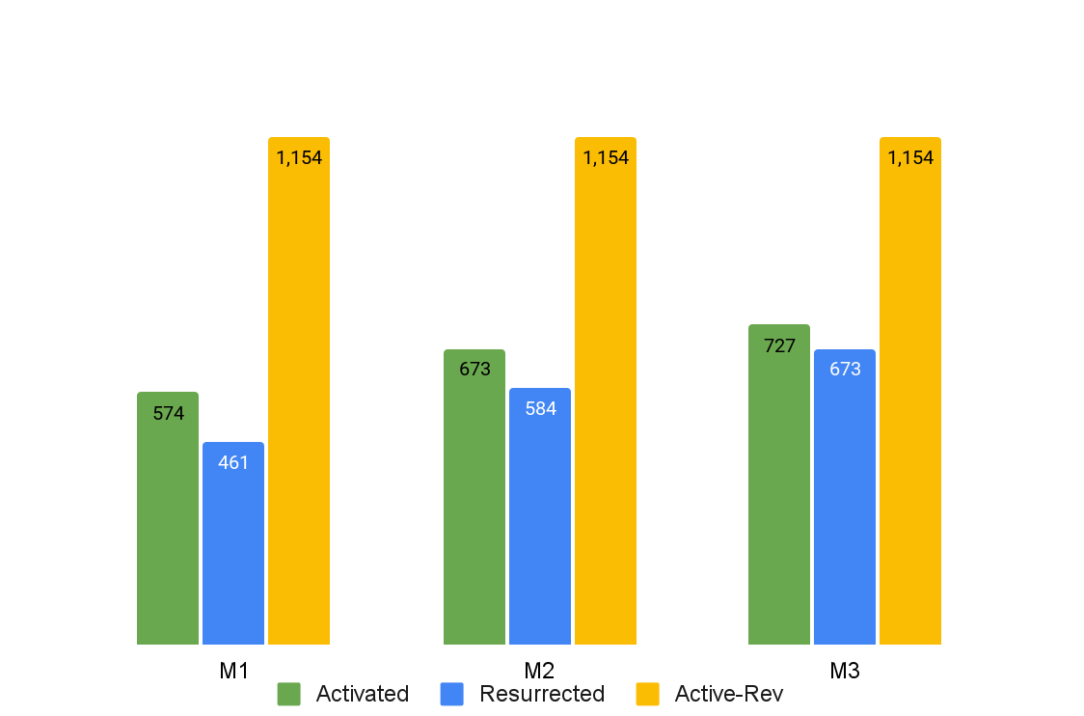
Active revisits pull Cost/MTM for overall revisits as 1.2x vs. onboardings
Overall cost of onboarding a merchant is 2.2x of revisiting; Cost/MTM is less due to higher incremental MTMs
Total Cost/MTM is higher for Revisited merch vs. Onboardings
Cost/ MTM for active revisits is highest; pulls up overall cost of revisit(~2x of onboardings and resurrections)
Optimise revisiting active merchants to optimize for cost/MTM
Note:
Cost/MTM for revisits include cost for resurrected and incremental retained merchants

Slide 10
Summary of Recommendations
What we found? | What we recommend? | How will it Impact?
Onboardings lead to 3.7x MTMs vs. Revisits in three months Quality of onboarded merchants is better than revisited merchants MoM; High Quality merchants retain longer Cost/MTM for onboardings is 1.2x lower vs. Revisits; Revisiting active merchants is the least cost effective > Onboardings > Inactive revisits | If Max. MTMs is the primary target, then Increase number of onboardings by repurposing revisits To ensure that the health of onboardings isn’t affected by market saturation, closely track the following: Activation rate: Reduction in activation rate can indicate reduction in willingness of merchant to adopt digital FOS productivity: Reduction in # merchants onboarded a day can indicate scarcity of merchants in market %HighInt activated merchants: Indicates quality of activated merchants remains high Optimize # of revisits based on following Targeted revisits strategy to max uplift MTMs facing stuck-settlement issues [WIP] MTMs based on churn-prediction model Revisits on-call feature in Merchant App [WIP] | Maximize MTMs: Onboardings lead to 3.7x MTMs vs. active revisits Maximize impact of revisits Improved merchant engagement, hence retention Optimize GPay coverage

Slide 11
Appendix

Slide 12
Scope of the analysis
Maximize
Total MTMs = Retained + Resurrected + New Activated
> Product Features
> Reliability
> Offers/Rewards
> Brand Preference
> Revisits - Relationship Management/TOM recall
> Organic
> FOS revisit
> OB calling
> Self Sign Ups
> FOS onboarded
Constraints
FOS strength (#5000)
FOS Productivity
Timeframe
Shivi to add which period we’ve run the analysis for
Used 3m period since the event to determine lt health
Note: Revisits can be used to solve for stuck settlements / introduce VAS features to merchants etc. too, impact of which cannot be assessed at this point due to lack of data on the same

Slide 13
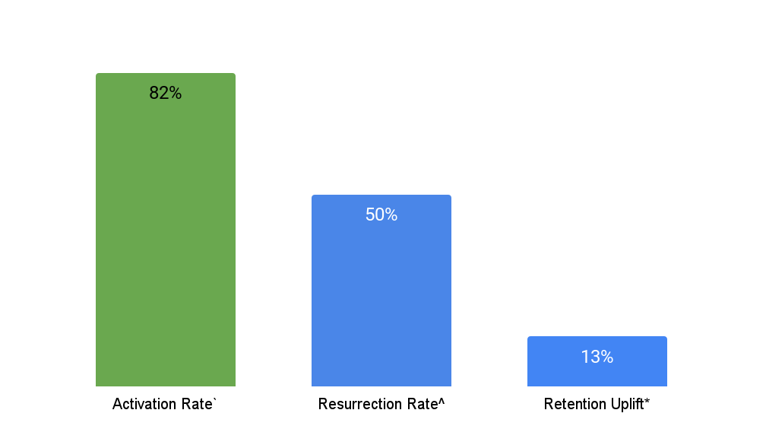
Appendix: Activation rate @82% is 1.5x resurrection rate & 6.3x retention uplift
Self-onboarding rate is @20% and organic resurrection @7%
FOS Incremental MTM
Total MTMs = Self-onboarded + Org resurrection + Retained MTMs + FOS Onboarded + FOS Resurrected + FOS Retained
FOS Incremental MTM = Onboarded*Activation Rate (%) + Inactive revisits*Resurrection Rate (%) + Active Revisits* Retention uplift (%)
20%
Self Signups
6% organic
FOS Onboarding
FOS Revisits
Onboardings generate higher number of immediate incremental MTMs
Note:
` Activation rate is calculated on 2 weeks window after onboarding date
^ Resurrection rate is calculated on 2 weeks window after revisiting date
* Retention uplift is difference b/w 28D retention for revisited and organic retention

Slide 14
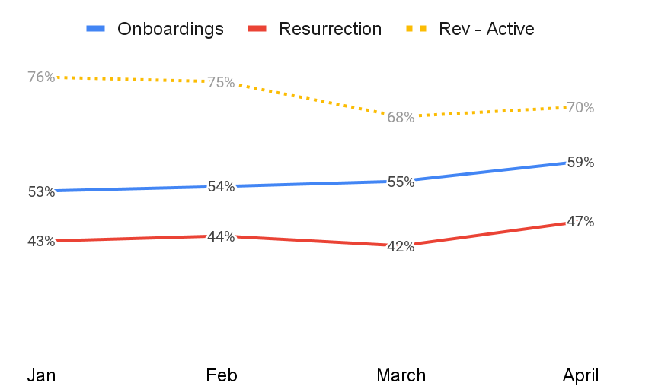
Higher # of 5. HighInt MTMs are generated via onboardings vs. revisits
Avg. TI within health segment 5 of resurrected merchants is 46 txns, while for activated merch it’s 54 txns
1.7M g
Never txd
3.7M
Inactive for >56D
0.8M fh
<=56D inactive
1.8M g
1-6 txn
2M g
>6 txn
3%
9%
31%
61%
96%
1. Never
2. Inactive
3. Churning
4. LowInt
5. HighInt
Improving health
%merchants in Seg5. highInt after activating, resurrecting and active-revisits
%highInt merchants before revisit: 59%
Incremental segment shift: 9% (Avg. 11% Feb-May)
%HighInt merchants have been increasing in activated merchants
%HighInt merchants are higher for activated merch vs. resurrected merchants
Note:
%HighInt merchants in active revisits is function of active base visited

Slide 15
Tl;dr Onboardings lead to higher long-term MTMs vs. Revisits
Cost/MTM for onboardings is higher than resurrection but lower than overall revisits (due to active revisits)
3.5x
Uplift in #MTMs by onboardings vs, revisits
1.2x
Cost/MTM for revisits vs. onboardings
59pp
HighInt merchants activated via Onboardings
Tl:Dr;
Onboarding leads to 3.7x MTMs vs. Revisits after three months
Quality of MTMs generated via onboardings is better vs. Revisits; Txn intensity (proxy for quality) has a direct correlation with retention of merchant as analysed in Health of 10M - Phase 2
Cost/MTM is 1.2x higher for revisits vs. onboardings
 | Total Ob | Total Revisits | Inactive @ Revisit | Active @ Revisit
FOS Agents | 2500 | 2500
FOS Productivity | 4 |  | 2 | 4
FOS Lift | 82% |  | 50% | 92%
Organic | 15% |  | 6% | 79%
Immediate | 6,690 | 1,660 | 880 | 780
M1 | 6,143 | 1,540 | 760 | 780
M2 | 5,236 | 1,379 | 599 | 780
M3 | 4,844 | 1,300 | 520 | 780
Why :
Activation rate @82% is 1.5x resurrection rate & 6.3x retention uplift
Onboarded merchants retain 11pp better vs. Resurrected after three months because onboardings lead to higher number of HighInt merchants vs. revisits
Transaction uplift on revisited active merchants only lasts for three months
Cost/MTM Active Revisits > Onboardings > Inactive Revisits; Active Revisits has the highest Cost/MTM because of lowest incremental MTMs vs. onboardings and inactive revisits
So What:
Increase onboardings by repurposing portion of revisits (active and inactive) to gain 200-400k incremental MTMs, assuming cost isn’t a constraint
If cost is a constraint, Re-purpose 75% of active revisits to onboardings to gain ~100k incremental MTMs (in M3) with the money saved on repurposing revisit
Note:
M1, M2 and M3 MTMs calculated based on calculated retention decay across all three FOS actions
Netted by Organic Onboardings (Self-signups), FOS Revisits , org, resurrection & retention to get to Incremental gain
Assuming total FOS agents as 5k are equally distributed b/w onboardings and revisited, and further 60%, 40% between active versus inactive revisits

